Slide 1

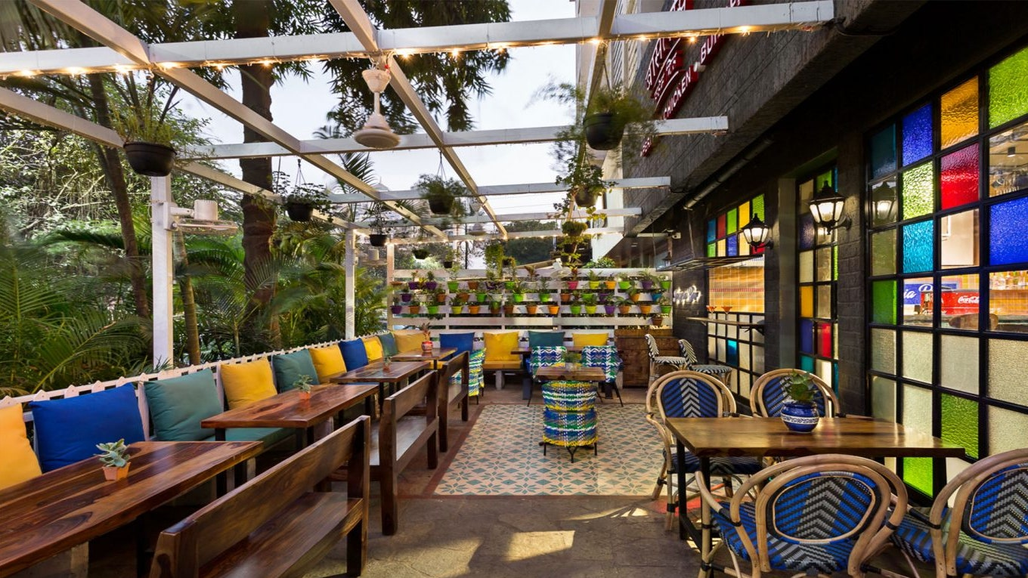
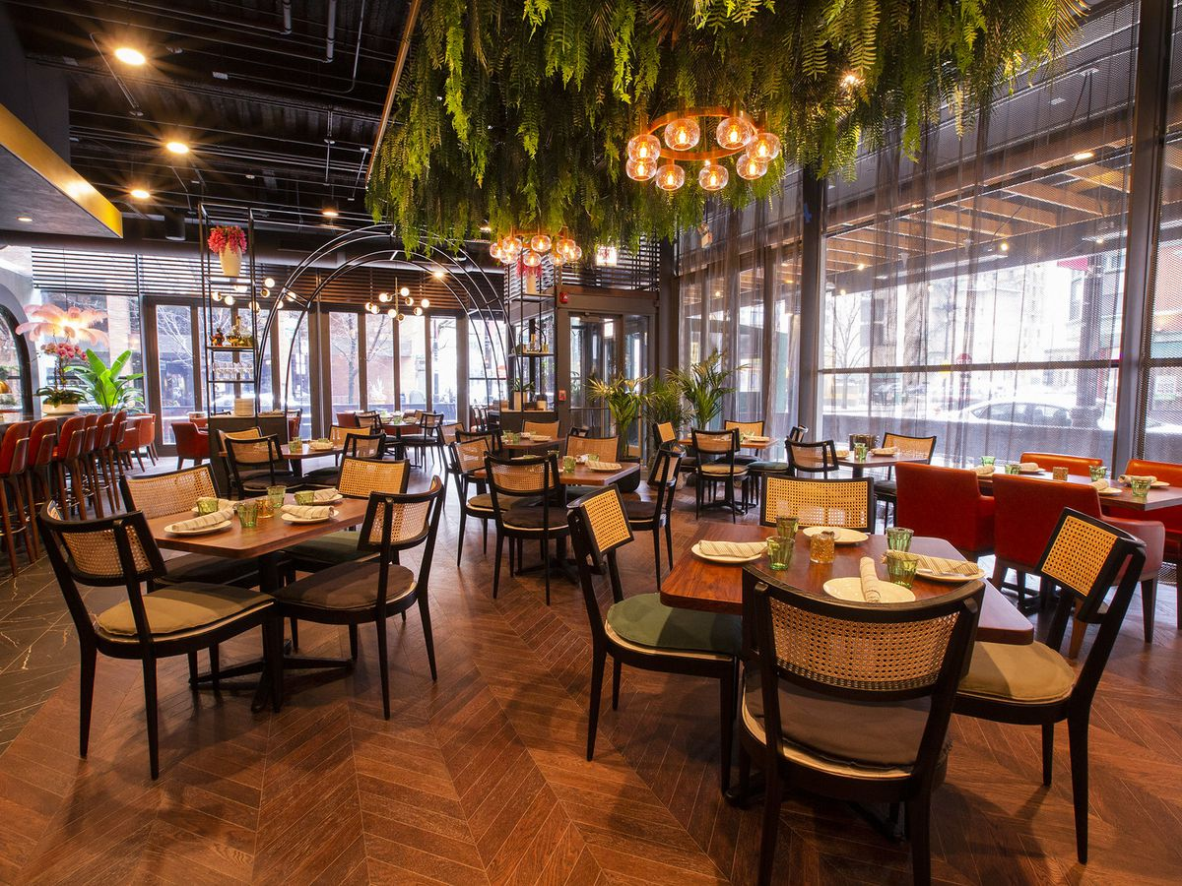
Project Of Restaurant

Slide 2
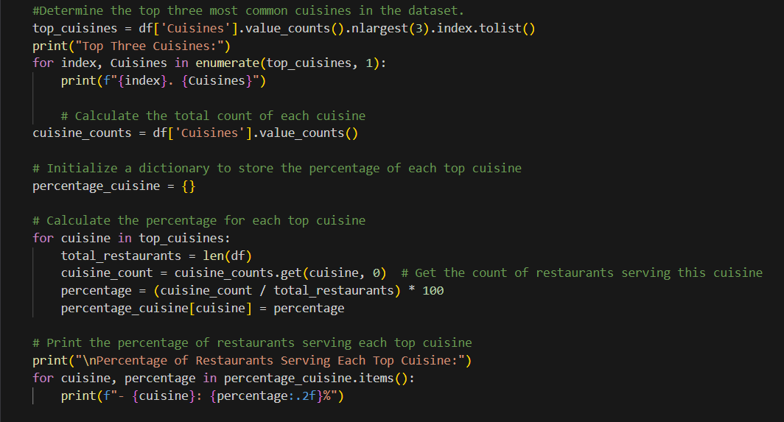
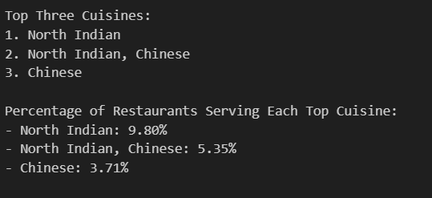
Level 1 Task 1 Task: Top Cuisines Determine the top three most common cuisines in the dataset. Calculate the percentage of restaurants that serve each of the top cuisines.

Slide 3
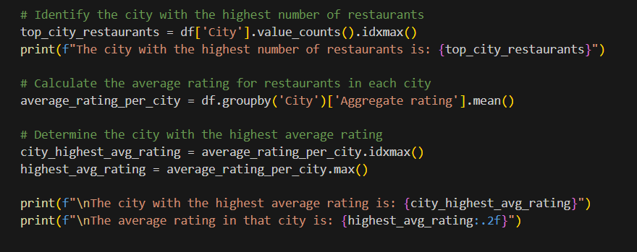
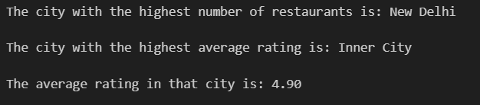
Level 1 task-2 Task: City Analysis Identify the city with the highest number of restaurants in the dataset. Calculate the average rating for restaurants in each city. Determine the city with the highest average rating.

Slide 4
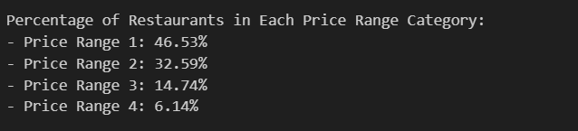
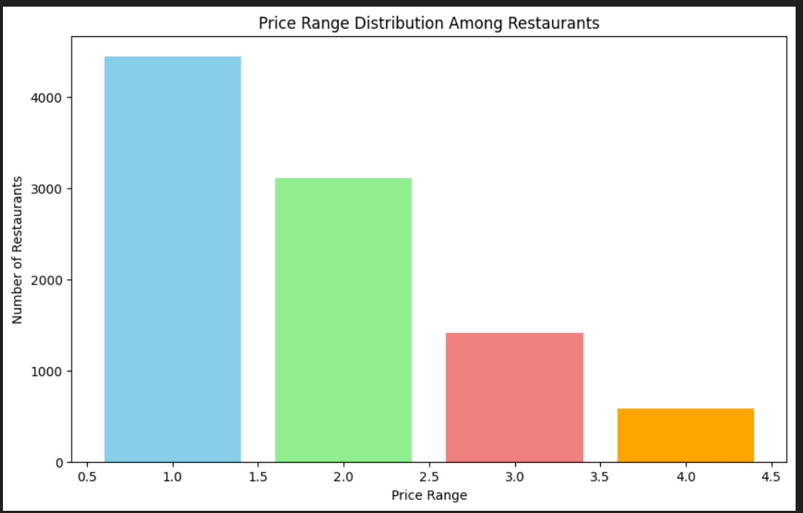
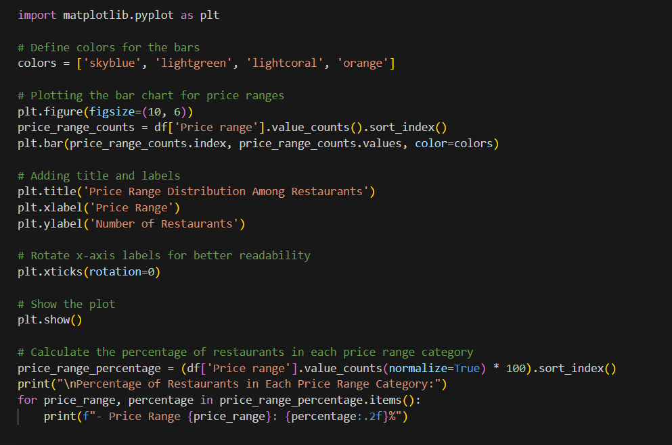
Level 1 Task 3 Task: Price Range Distribution Create a histogram or bar chart to visualize the distribution of price ranges among the restaurants. Calculate the percentage of restaurants in each price range category.

Slide 5
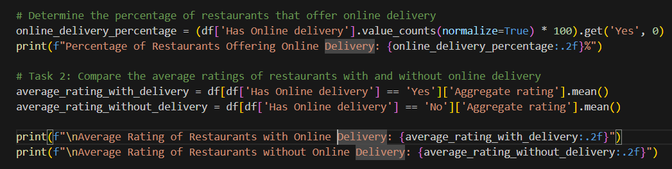
Level 1 Task 4 Task: Online Delivery Determine the percentage of restaurants that offer online delivery. Compare the average ratings of restaurants with and without online delivery.

Slide 6
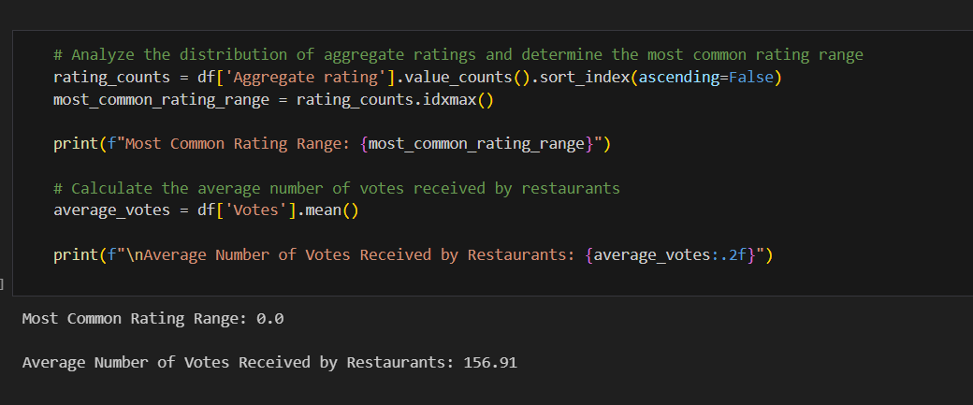
Level 2 Task 1 Task: Restaurant Ratings Analyze the distribution of aggregate ratings and determine the most common rating range. Calculate the average number of votes received by restaurants.

Slide 7
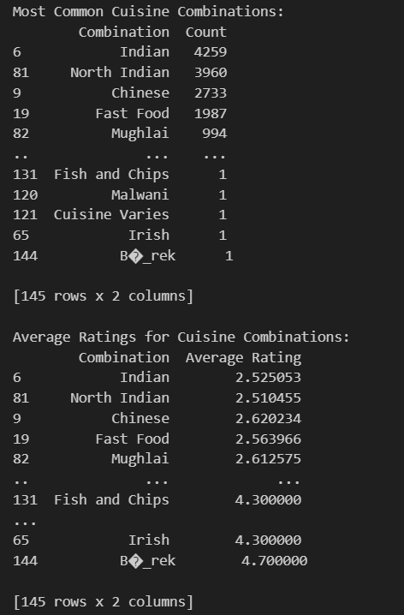
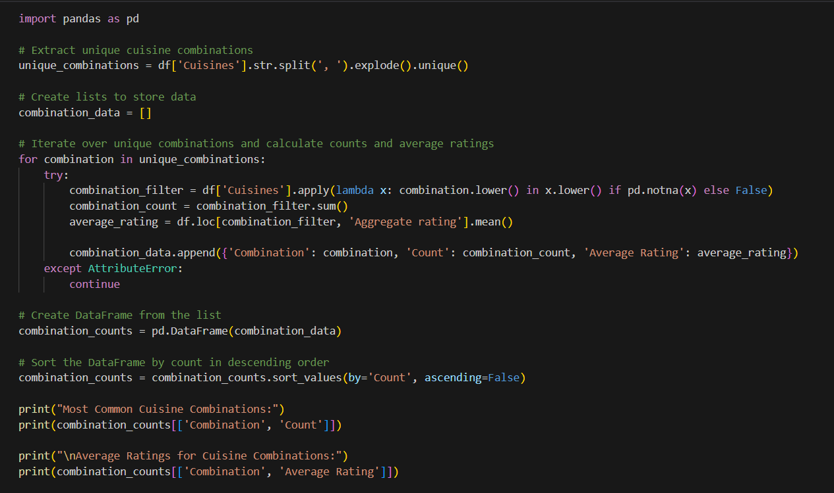
Level 2 Task 2 Task: Cuisine Combination Identify the most common combinations of cuisines in the dataset. Determine if certain cuisine combination stend to have higher ratings.

Slide 8
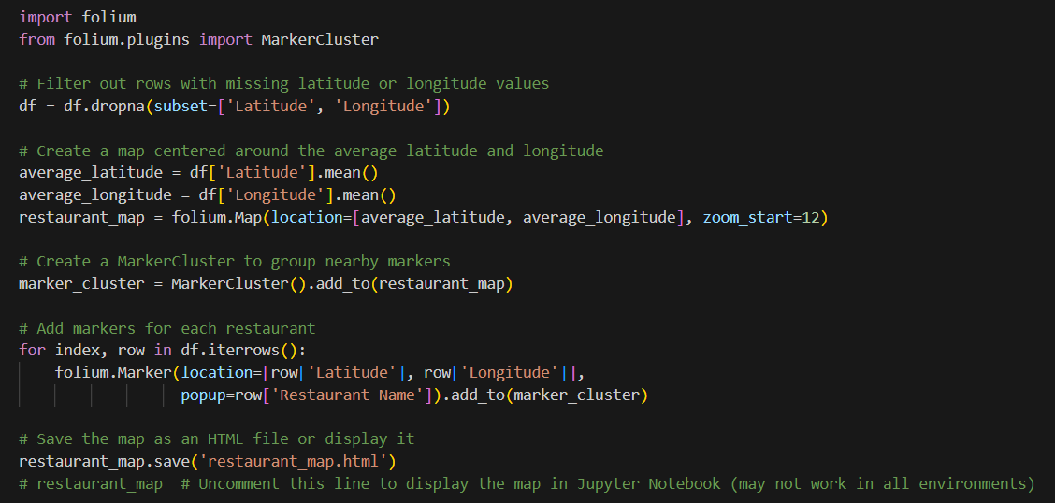
Level 2 Task 3 Task: Geographic Analysis Plot the locations of restaurants on a map using longitude and latitudecoordinates. Identify any patterns or clusters of restaurants in specific areas.

Slide 9
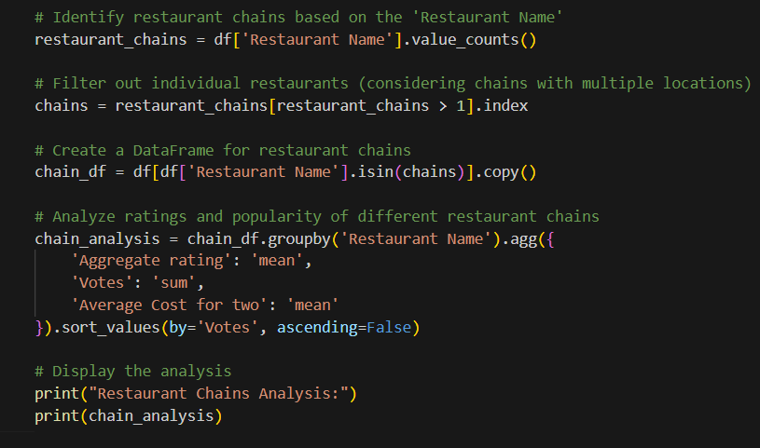
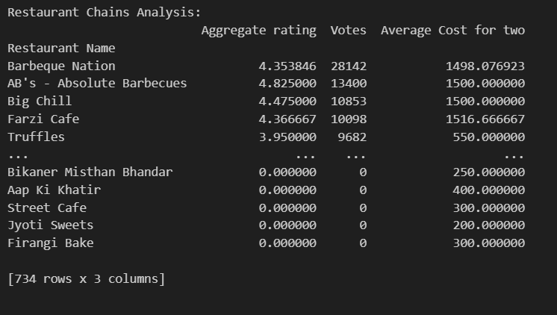
Level 2 Task 4 Task: Restaurant Chains Identify if there are any restaurant chains present in the dataset. Analyze the ratings and popularity of different restaurant chains.

Slide 10
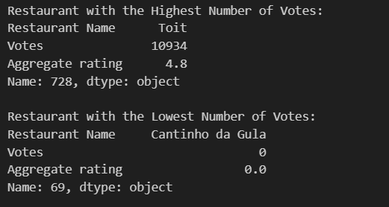
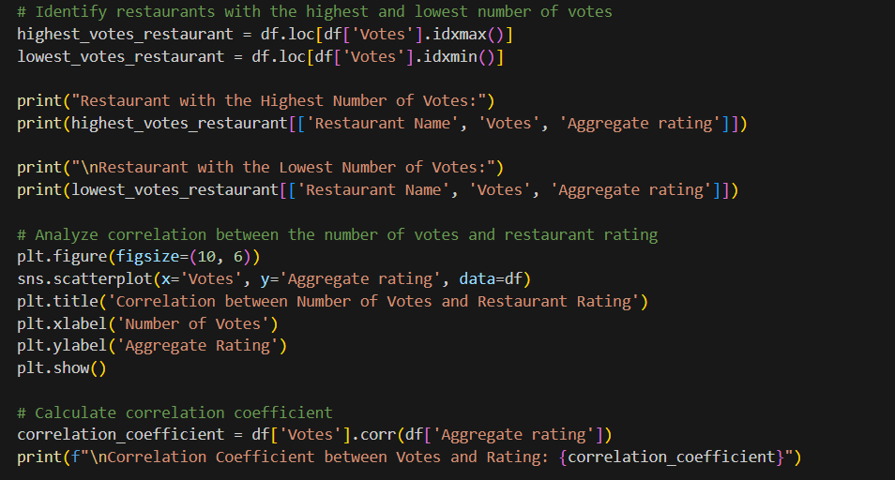
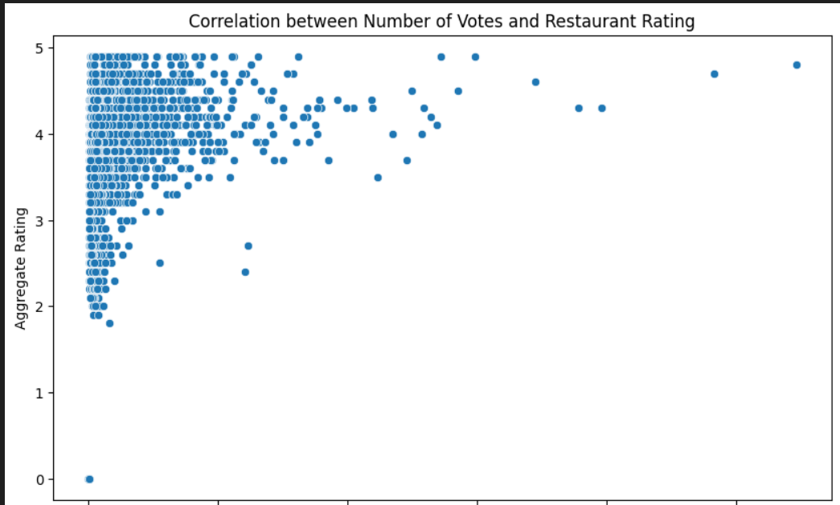
Level 3 Task 2 Task: Votes Analysis Identify the restaurants with the highest and lowest number of votes. Analyze if there is a correlation between the number of votes and the rating of a restaurant.

Slide 11
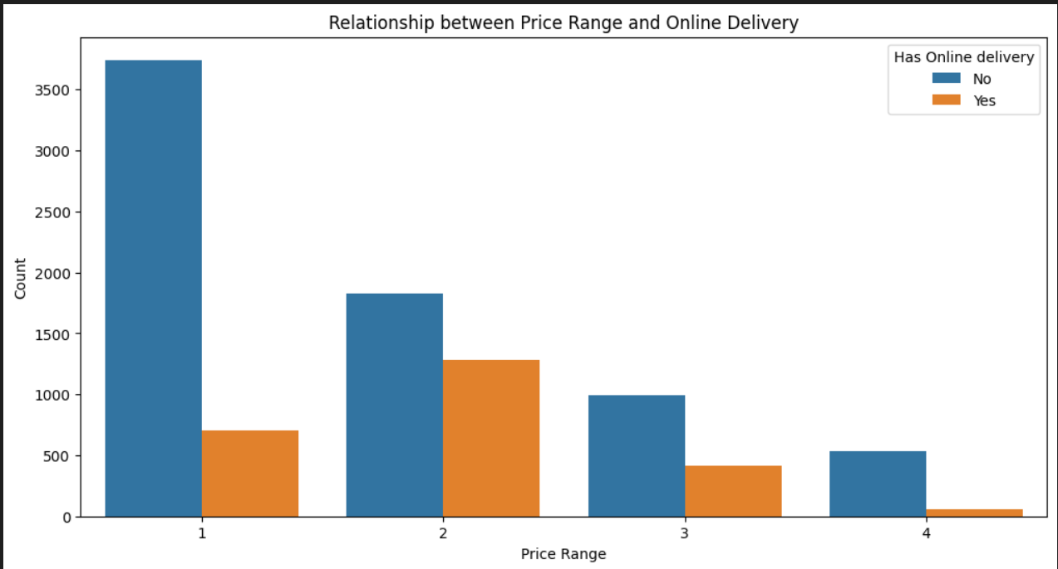
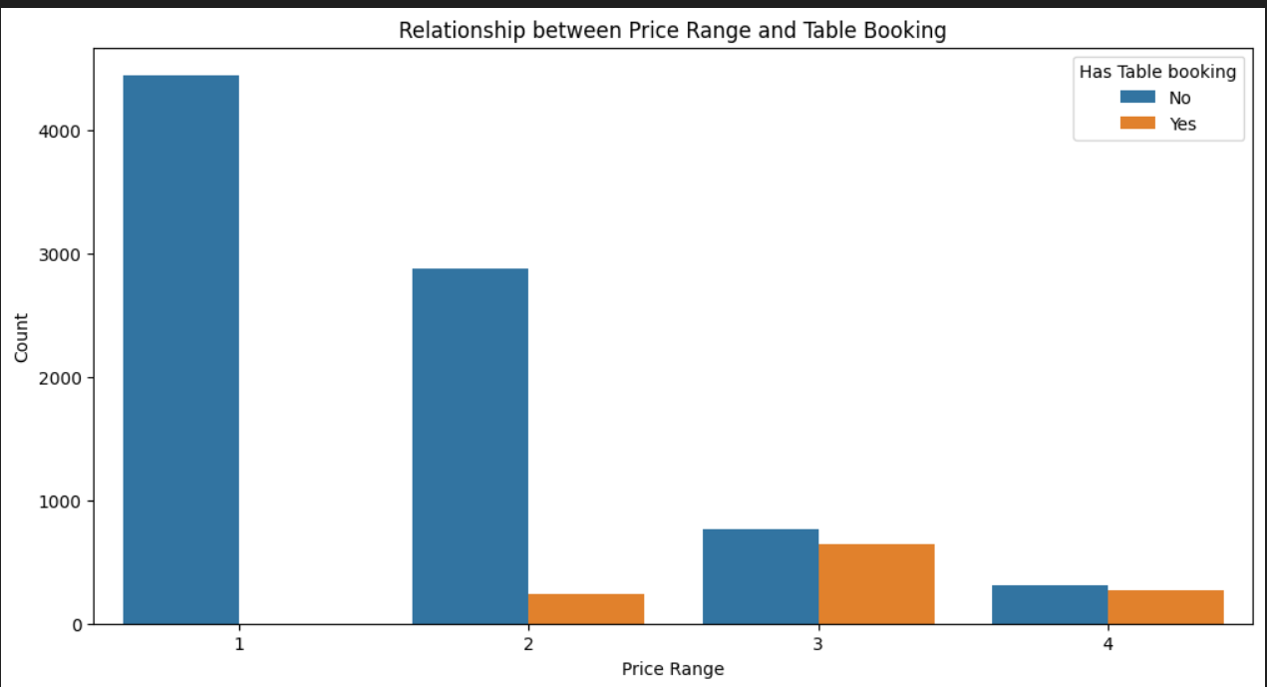
Level 3 Task 2 Task: Price Range vs. Online Delivery and Table Booking Analyze if there is a relationship between theprice range and the availability of online delivery and table booking. Determine if higher-priced restaurants are more likely to offer these services.

Slide 12
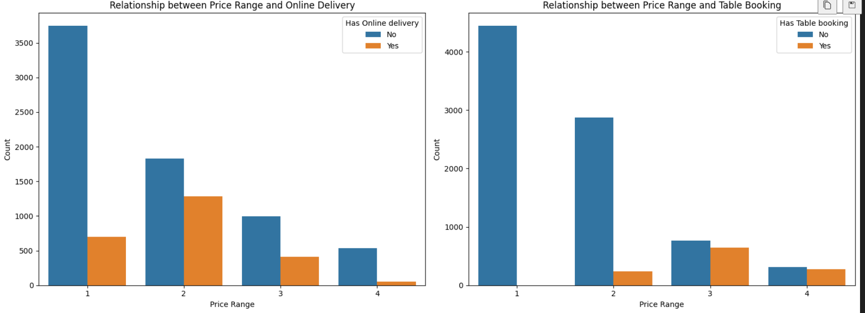
Determine if higher-priced restaurants are more likely to offer these services.

